Slide 1


Introduction to SNORT IDS
SNORT IDS, also known as Snort Intrusion Detection System, is a powerful open-source network intrusion detection system. It is widely used for real-time traffic analysis and packet logging on IP networks. SNORT IDS helps in detecting and preventing various types of attacks, including malware infections, denial-of-service (DoS) attacks, and much more.
by Sridhar Iyer

Slide 2
What is SNORT IDS?
Intrusion Detection System
Packet Sniffer
A software used to monitor network and system activities.
It captures and analyzes network traffic in real-time.
Rule-Based Detection
Action on Detection
Identifies patterns indicative of malicious activities.
Alerts or takes action against detected threats.

Slide 3

Why use SNORT IDS?
Real-time threat detection: SNORT IDS provides real-time monitoring and detection of network threats, ensuring immediate response to potential security breaches.
Customizable rule sets: Users can create and customize their own rule sets, tailoring them to specific network environments and security requirements.
Open-source and community support: Being open-source, SNORT IDS benefits from a large community of users and contributors, providing continuous development and support.

Slide 4
Overview of SNORT IDS architecture
1
Packet Capture and Preprocessing
Raw packet data is captured and preprocessed for analysis.
2
Signature-Based Detection
Comparison of packet contents with predefined signatures to identify known threats.
3
Anomaly-Based Detection
Identification of abnormal network behavior using established baseline patterns.

Slide 5
SNORT IDS installation and setup
Installation Steps
Setup Considerations
Download the latest SNORT IDS package from the official website.
During the setup, configure the network interfaces and define the monitoring policy.
Follow the installation instructions provided for your specific operating system.
Create rules for handling specific types of traffic and set up logging for alerts.
Ensure that all necessary dependencies are met before proceeding with the setup.

Slide 6

System Requirements for SNORT IDS
The system requirements for SNORT IDS include a minimum of 1GB of RAM and at least 10GB of available disk space. It is essential to have a compatible network interface card (NIC) that supports promiscuous mode for packet sniffing. Additionally, ensure that the operating system is supported by SNORT IDS, such as Windows, Linux, or macOS.

Slide 7
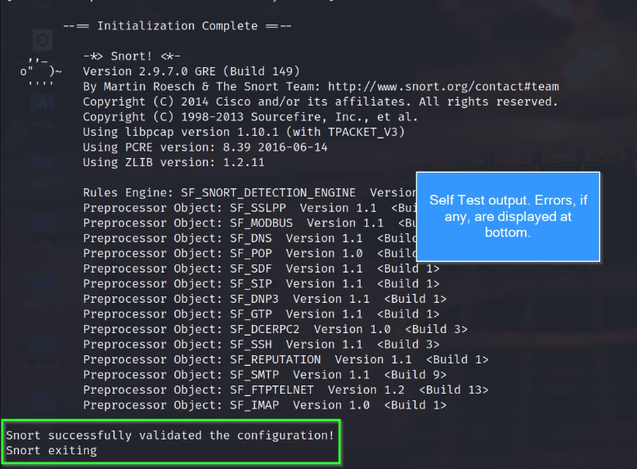
Installing SNORT IDS on Windows
Installing SNORT IDS on Windows involves downloading the appropriate installer from the official website and following the step-by-step installation guide provided. The installation process requires administrative privileges and configuring network settings for monitoring.

Slide 8
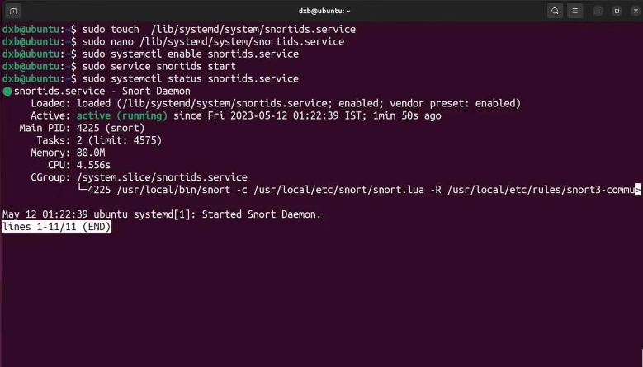
Installing SNORT IDS on Linux
Installing SNORT IDS on Linux involves downloading the source package, extracting it, and configuring it as per system requirements.
Download the latest version of SNORT IDS from the official website.
Extract the downloaded package using the tar command.
Configure SNORT IDS using the appropriate commands and options.

Slide 9
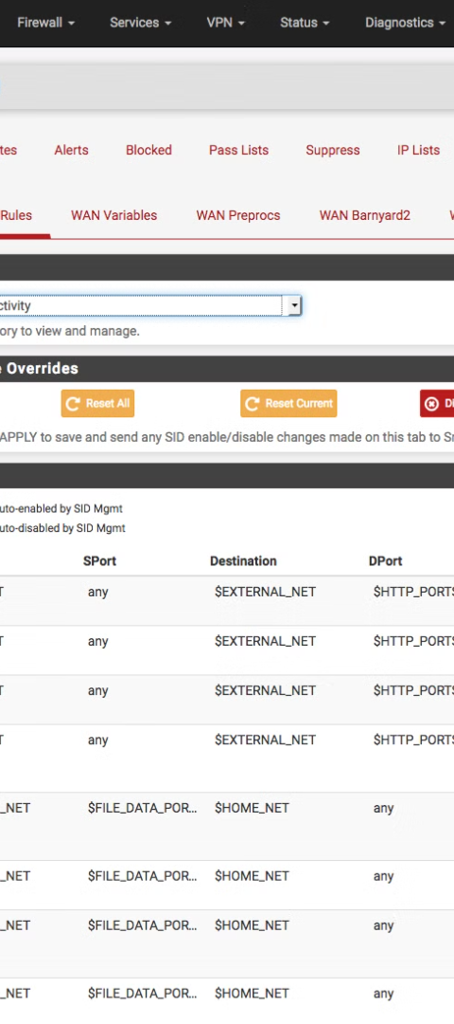
Configuring SNORT IDS
Configuration File
Rule Management
Modify the configuration file to define network segments and detection rules.
Utilize rule management tools to enable, disable, or modify specific detection rules.
Logging and Logging Management
Configure logging settings and manage logged information to track detected threats and system performance.

Slide 10

Understanding SNORT IDS rules
Rule Components: Each rule consists of a header, options, and a rule body.
Header: Contains the action, protocol, source IP, source port, direction symbol, destination IP, and destination port.
Rule Options: Define the conditions under which the rule should be applied.
Rule Body: Specifies the pattern to be matched in the packet payload.

Slide 11

Types of SNORT IDS rules
Signature-based rules: Utilize predefined patterns to detect known threats, such as viruses, malware, and specific network behaviors.
Anomaly-based rules: Identify deviations from normal network traffic patterns by establishing a baseline and flagging abnormal activities.
Policy-based rules: Enforce specific organizational or compliance policies by monitoring and controlling network activities.

Slide 12

Writing custom SNORT IDS rules
Understanding SNORT rule syntax: Explaining the structure of SNORT rules and how to define custom signatures for specific threats.
Rule header format: Covering the header components such as action, protocol, source, destination, and more.
Rule options and content: Describing the various rule options and their impact on threat detection and prevention.

Slide 13
SNORT IDS Rule Syntax
The SNORT IDS rule syntax follows a structured format with specific components. It includes the rule header, which defines the action, protocol, source, and destination. The rule options provide additional criteria for matching network traffic, such as content, metadata, and flow. Understanding the syntax is crucial for effective rule creation and management.

Slide 14
Rule options and modifiers
Rule Options
Rule Modifiers
Rule options in SNORT IDS provide additional criteria for matching and classifying network traffic. They allow for fine-grained control over rule behavior.
Modifiers in SNORT IDS enable the customization and refinement of rule actions. They can be used to modify rule behavior based on specific conditions.

Slide 15
Rule actions and logging
Action Types
Logging Details
SNORT IDS rule actions include alerting, logging, and blocking of network traffic.
SNORT logs provide detailed information about detected intrusions, including source and destination IP addresses, timestamps, and attack signatures.
Each action type provides different levels of response to detected threats.
Log files are essential for post-incident analysis and threat intelligence.

Slide 16
SNORT IDS Rule Management
Rule Organization
Rule Versioning
SNORT IDS rules should be organized based on severity and relevance.
Version control is crucial for managing updates and changes to rules.
Rule Testing
Rule Maintenance
Thorough testing ensures effective rule deployment and performance.
Regular maintenance is necessary for optimal rule effectiveness and accuracy.

Slide 17




Rule Management Tools and Utilities
Database Management
Configuration Tools
Dashboard Visualization
Rule Update Management
Efficiently manage rule databases and perform quick searches for specific rules.
Tools for easily configuring and customizing SNORT IDS rules and settings.
Visual representation of rule performance and system status for easy monitoring.
Tools to manage and schedule automatic updates for SNORT IDS rules.

Slide 18
Updating SNORT IDS rules
1
Research New Rules
Identify and review the latest SNORT IDS rule updates from official sources and security communities.
2
Evaluate Impact
Analyze the potential impact of new rules on network performance, resource utilization, and false positives.
3
Testing and Deployment
Thoroughly test and deploy updated rules in a controlled environment to ensure effectiveness and minimal disruption.

Slide 19
Monitoring SNORT IDS Alerts
1
Alert Generation
SNORT IDS constantly monitors network traffic to identify and generate alerts for suspicious or potentially malicious activity.
2
Alert Classification
Classifying alerts based on severity and relevance to security policies is crucial for effective incident response.
3
Alert Notification
Notifying security personnel or administrators about detected alerts in real-time for prompt investigation and resolution.

Slide 20
Viewing SNORT IDS alerts in real-time
1
Accessing Real-time Alerts
Log in to the SNORT IDS dashboard and navigate to the real-time alerts section.
2
Filtering Alert Types
Utilize filtering options to narrow down alerts based on severity, source, or destination.
3
Monitoring Live Activity
Observe the live traffic and alerts as they occur in real-time for immediate response.

Slide 21
Analyzing SNORT IDS alerts
Identifying Patterns
Real-time Analysis
Behavioral Analysis
Analysts examine alert patterns to identify potential security threats.
Real-time monitoring enables instant response to critical alerts, preventing potential breaches.
Behavioral anomalies are analyzed to detect sophisticated, evolving threats.
Correlating alerts helps in pinpointing network vulnerabilities and attack trends.
Utilizing behavioral analysis enhances the accuracy of threat detection and response.
Quick analysis and response minimize the impact of security incidents.

Slide 22



SNORT IDS alert correlation
Alert Aggregation
1
Grouping similar alerts for analysis
Event Correlation
2
Identifying patterns across multiple alerts
Contextual Analysis
3
Examining alerts in the broader system context

Slide 23
SNORT IDS log analysis
Data Collection
1
Gathering log files from sensors
Preprocessing
2
Formatting and parsing log data
Anomaly Detection
3
Identifying abnormal network behavior

Slide 24
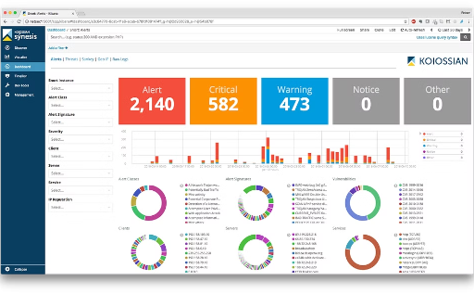
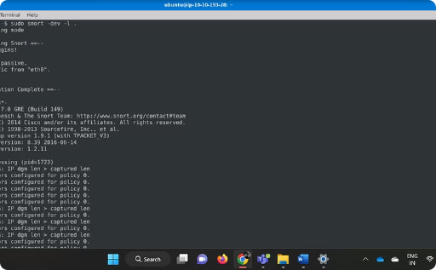
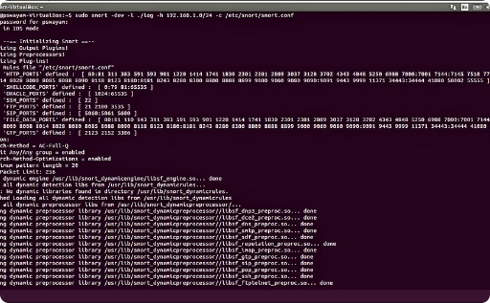
SNORT IDS Reporting and Visualization
Alerts Dashboard
Real-time Event Log
Network Traffic Visualization
A comprehensive dashboard displaying SNORT IDS alerts, categorized and visualized for easy analysis and interpretation.
A detailed real-time log illustrating SNORT IDS events with timestamps, event types, and source/destination IP addresses
A 3D visual representation of SNORT IDS network traffic, showcasing packet flow, anomalies, and potential threats

Slide 25
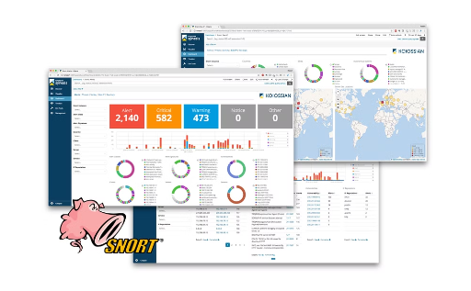
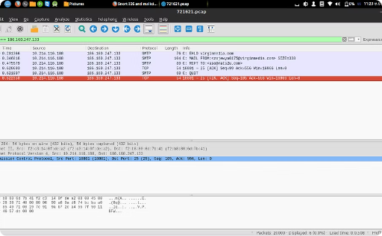
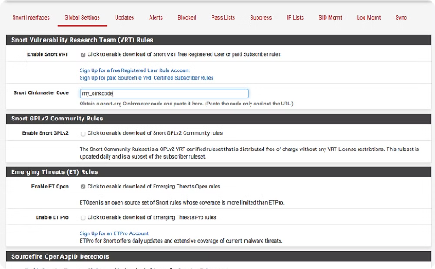
Real screenshots of SNORT IDS in action
Real-time Alert Dashboard
Packet Analysis
Rule Management Interface
Displayed is the SNORT IDS packet analysis window, highlighting and analyzing suspicious network traffic for potential threats.
The screenshot shows the SNORT IDS alert dashboard capturing real-time network intrusion alerts with detailed information.
This screenshot illustrates the SNORT IDS rule management interface, demonstrating rule configuration and modification for effective threat detection.

Slide 26

Conclusion and Next Steps
As we conclude our exploration of SNORT IDS, the next steps involve practical application and further study. Implementing SNORT in a real-world context and continuous learning about network security are essential. Engaging with industry best practices and staying updated on emerging threats will be crucial for success.

